Slide 1


Analytics
Mentor : Mr. Adam Shafi
Date : 25 September 2021

Slide 2

Project By
Sonali Mahamuni
Kalyani Bagal
Snehal Hatkar
Aanand Lele
Mayuresh Pathak

Slide 3
Business Objective
There is an ever-increasing focus on effective recruitment. An organization invests a lot of its time and resources in search of the potential candidates. The investment become loses if the selected candidates do not join the organization in the end.

Slide 4
Project Flow
Week 1: Data Set Details
Week 2: Data Analysis
Week 3&4: Data Visualization
Week 5: Final Presentation

Slide 5
Data Set Details
Variable | Levels
Id - | candidates id
Age - | 0: '19-26', 1: '27-33', 2: '34-40', 3: '40 above'
Gender - | 0: 'Male', 1: 'Female'
Marital_status - | 0: 'Single', 1: 'Married'
Num_comp_worked - | 0: '0-2', 1:'3-5', 2: '6-8', 3: '9 above'
Work_experience - | 0: '2', 1: '5', 2: '8', 3: '8 above'
Last_salary- | 0: '1-3.5K', 1: '3.5-7K', 2: '7-10K', 3: '10-15K' , 4: '15K above'
Salary_hike- | 0: '<25%', 1: '25-50%', 2: '50-75%', 3: '75-100%' , 4: '100% above'
Work_hours - | 0: 'Mon-Fri', 1: '24/7 operation', 2: 'Flexible hours'
Traveling_required - | 0: 'No', 1: 'Yes'
noticeperiod_buyout- | 0: 'No', 1: 'Yes'
Job_type- | 0: 'Contract', 1: 'Permanent'
Com_Possess_vehicle- | 0: 'No', 1: 'Yes'
Work_location- | 0: 'Outskirt town', 1: 'Town', 2: 'Business Center'
Travel_to_work_distance&_time - | 0: 'near', 1: 'average', 2: 'far'
Work_area_living_cost - | 0: 'low cost', 1: 'average', 2: 'high cost'
Public_transport_nearby - | 0: 'No', 1: 'Yes'}
Current_employment- | 0: 'Unemployed/Resigned', 1: 'Working'

Slide 6
Offerletter_Processtime(week)- | 0: 1, 1: 2, 2:3, 3:4, 4:5
Bonus- | 0: 'No', 1: 'Yes'
Allowance- | 0: 'No', 1: 'Yes'
Overtime_pay- | 0: 'No', 1: 'Yes'
Emp_shares_scheme- | 0: 'No', 1: 'Yes'
Performance_incentive- | 0: 'No', 1: 'Yes'
Annual_leave- | 0: 'less 12 days', 1: 'more 12 days'
Medical_Family- | 0: 'No', 1: 'Yes'
Child_day_care- | 0: 'No', 1: 'Yes'
Nursing_room - | 0: 'No', 1: 'Yes'
Parking - | 0: 'No', 1: 'Yes'
Comp_size - | 0: 'less than 200', 1: '200-500'} , 2: '500-2000'} ,3: '2000-5000'} , 4: 'more than 5000'
Comp_rating - | 0:low to 4:high
Work_life_balance- | 0:low to 4:high
Stresslevel- | 0:low to 4:high
Accept_offer- | 0: 'No', 1: 'Yes'

Slide 7
Data Types
Variable | Datatype | Missing Values
Id | Integer | 0
Age | String | 0
Gender | String | 0
Marital_status | string | 0
Num_comp_worked | String | 0
Work_Experience | String | 0
Last_salary | String | 0
Salary_hike | String | 0
Work_hours | String | 0
Traveling_required | String | 0
noticeperiod_buyout | String | 0
Job_type | String | 0
Com_Possess_vehicle | String | 0
Work_location | String | 0
Travel_to_work_distance&_time | String | 0
Work_area_living_cost | String | 0
Public_transport_nearby | String | 0
Current_employment | String | 0

Slide 8
Offerletter_Processtime(week) | Integer | 0
Bonus | String | 0
Allowance | String | 0
Overtime_pay | String | 0
Emp_shares_scheme | String | 0
Performance_incentive | String | 0
Annual_leave | String | 0
Medical_Family | String | 0
Child_day_care | String | 0
Nursing_room | String | 0
Parking | String | 0
Comp_Size | String | 0
Comp_rating | String | 0
Work_life_balance | String | 0
Stresslevel | String | 0
Accept_offer | String | 0

Slide 9
Week 2

Slide 10
Data Analysis

Slide 11
Week 3

Slide 12
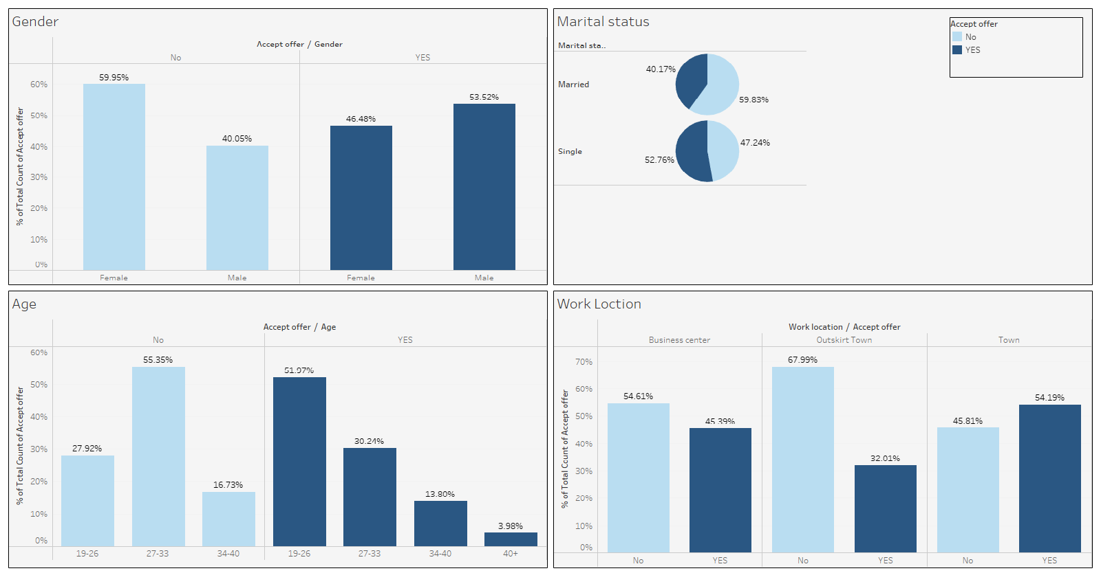
Insights
:

Slide 13
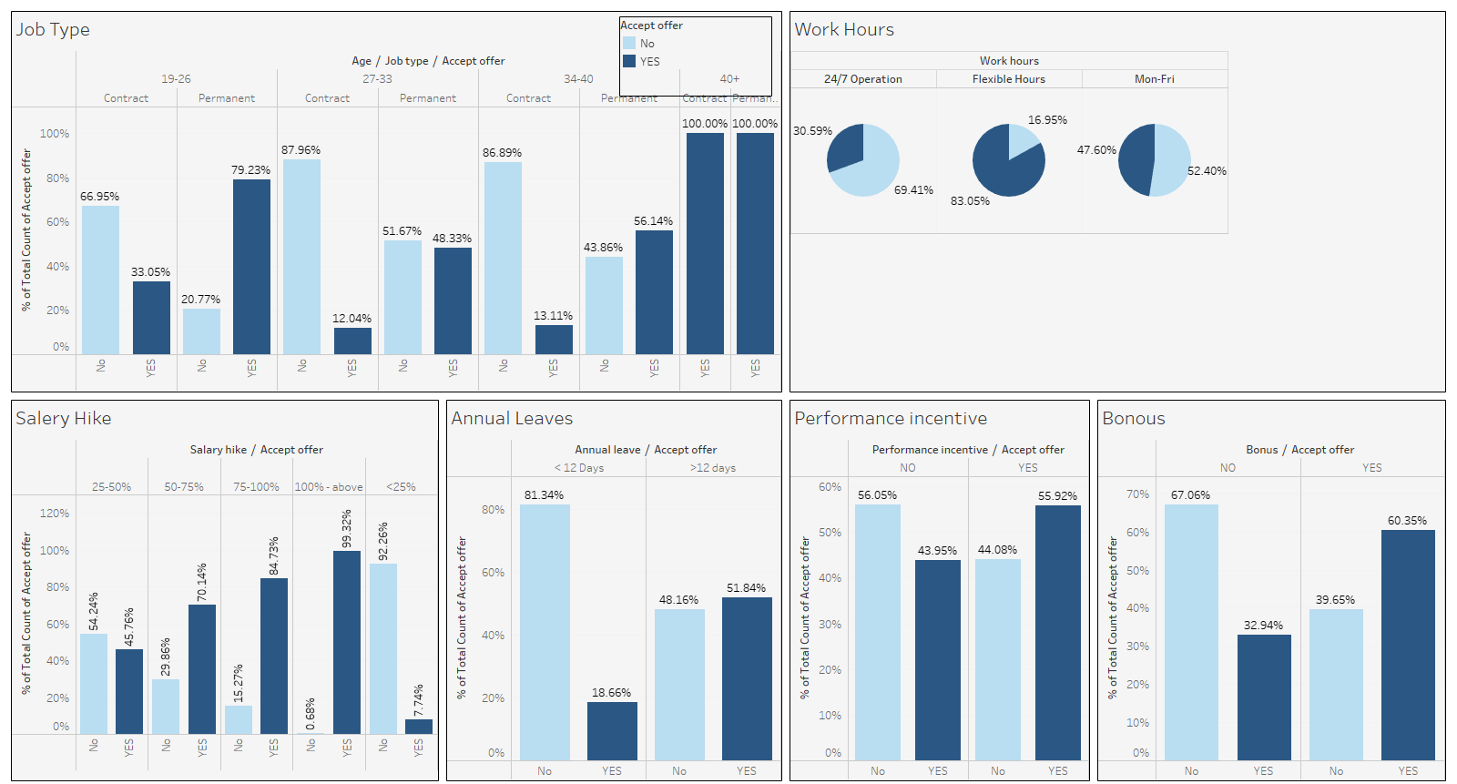

Slide 14
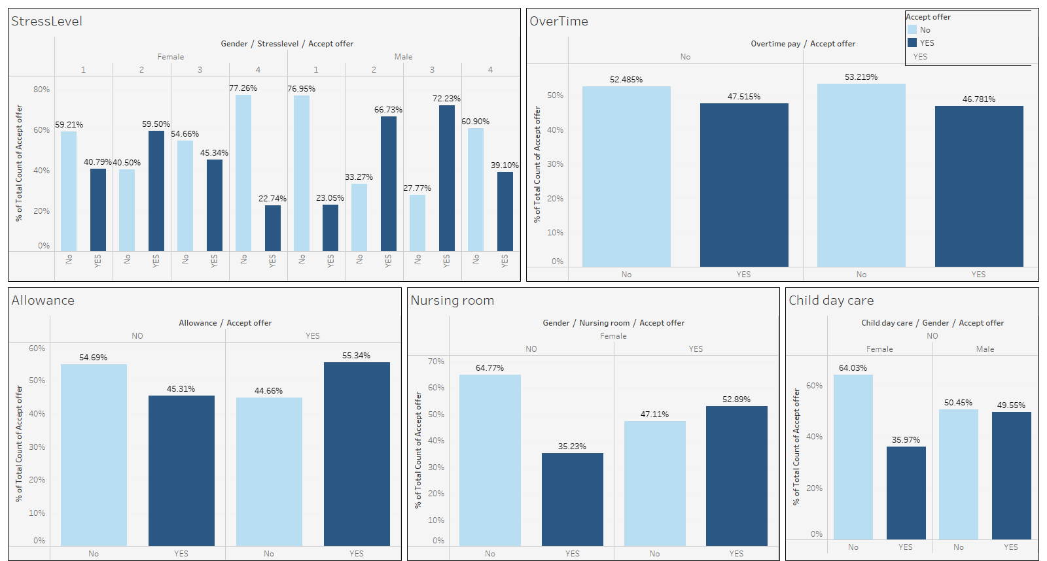

Slide 15
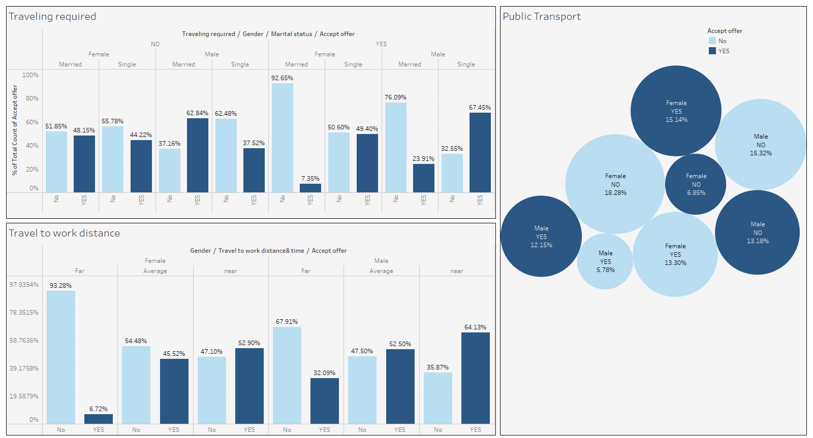

Slide 16

Conclusion
Here,we can conclude that, With the right understanding and implementation, data that is quantifiable can now be used as an essential metric for long-term success in recruiting, retaining, and managing people.
Overall Offer rejection rate is higher than acceptance rate(52.31% peoples are rejecting the offer)
If we focus on gender,offer acceptance rate is low in female as compared to male,because females are more concerned about distance,travel facilities and nursing care.

Slide 17
Thank You

